Slide 1

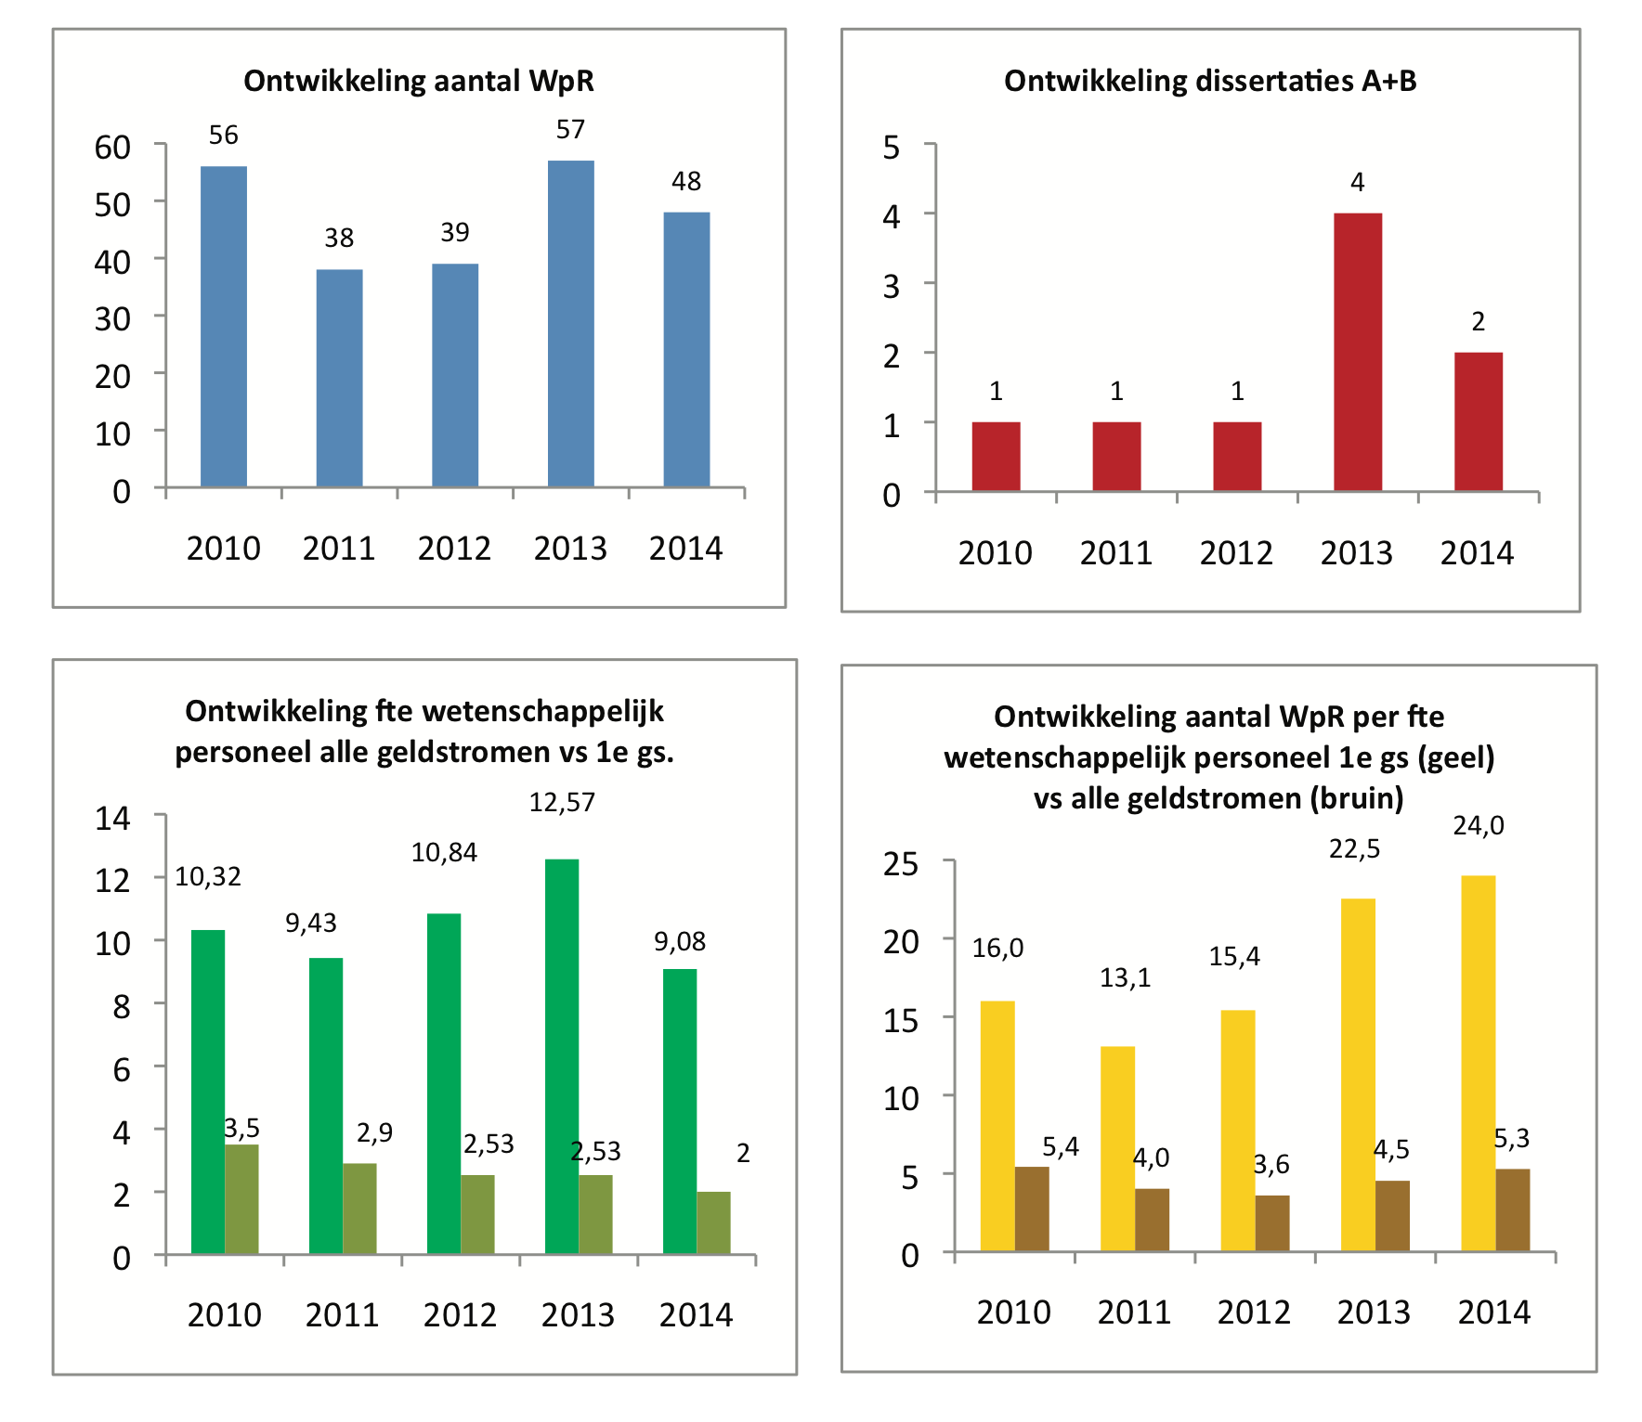
Amsterdam Movement Sciences
Titel: Ihil earchita a voluptae con aut fugit
omig endipiciis ini coratem est modis aliquatem.
Ment am re conseditatur aut dolupta iniatur aut adit eost que inis veris voloreto.
Name Author, Department this and that, Amsterdam UMC; Name author², Department this and that, Harvard University Hospital, Name Author³, Department this and so, Maastricht UMC, Name Author, Department this and that, Amsterdam UMC; Name author ², Department this and that, Harvard University Hospital, Name Authorr³, Department this and so, Maastricht UMC
Inspired by motion
Introduction
Mix above ingredients and knead into a semi soft dough. Knead until satiny and elastic- add flour sparingly as needed. Put into greased bowl, turn to put oily side up. Cover and let rest for at least 20 minutes in a warm (not hot) area Cover table with old (but clean!!!) bedsheet or old white.
Dust with flour.Take dough out of bowl and roll out to a rectangular shape. Brush with oil. Cover hands with flour and put hands (back side up) under dough and start pulling dough out - if you use inside of hands, it might work for a while but you will soon poke holes into the dough with your fingers. Always pull from the middle out.
(You will have thicker edges - just cut them off at the end of the pulling. If you have a hole, don’t worry - just take a flour and put hands (back side up) under dough and start piece of the thicker edges, pu.
Results
Now distribute about 4 lbs of acidic apples (Granny Smith or the like) peeled and cut (not too thinly) apples on top of dough (I always drop them into water mixed with lemon juice after peeling and cutting) - add about 1/4 craisins and 1/4 finely Now distribute about 4 lbs of acidic apples (Granny Smith or the like) peeled and cut (not too thinly) with lemon juice somehow it always works out) - make sure the seam is underneath! Brush Strudel withpre heated oven about 30 -40 minutes at about.
Raisins and 1/4 finely chopped walnuts (or to taste), drizzle with lemon juice and sprinkle with cinammon and (powder)
(You will have thicker edges - just cut them off at the end of the pulling. If you have a hole, don’t worry - just take about.
Conclusion/Discussion
Pick up the cloth on its long side with two hands spaced apart and start rolling up the Strudel (use cloth only!).
When done, you need at least 2 pair of hands to “heave ho” the long Strudel onto a greased baking sheet.
You can either put it into a U shape if the cookie sheet is big enough or cut it into two, cover the openings with foil and put onto two sheets (this is my least favorite part but apples (Granny Smith or the like) peeled and cut (not too thinly) apples on top of dough (I always drop them into somehow it always works out) - make sure the seam is underneath! Brush Strudel with melted butter and bake in preheated oven about 30.
Fig. 1 - 4
References
like Mohnnudeln, Zwetschkenknoedl, Palatschinken,
Kaiserschmarrn, etc I loved so much) or cold, serve covered with powdered sugar (icecream is just as good with this as with American apple

Slide 2
Amsterdam Movement Sciences
Titel: Ihil earchita a voluptae con aut fugit
omig endipiciis ini coratem est modis aliquatem.
Inspired by motion
Name Author, Department this and that, Amsterdam UMC; Name author², Department this and that, Harvard University Hospital, Name Author³, Department this and so, Maastricht UMC, Name Author, Department this and that, Amsterdam UMC; Name author ², Department this and that, Harvard University Hospital, Name Authorr³, Department this and so, Maastricht UMC
Introduction
Mix above ingredients and knead into a semi soft dough. Knead until satiny and elastic- add flour sparingly as needed. Put into greased bowl, turn to put oily side up. Cover and let rest for at least 20 minutes in a warm (not hot) area Cover table with old (but clean!!!) bedsheet or old white tablecloth. Dust with flour.Take dough out of bowl and roll out to a rectangular shape. Brush with oil. Cover hands with flour and put hands (back side up) under dough and start pulling dough out - if you use inside of hands, it might work for a while but you will soon poke holes into the dough with your fingers. Always pull from the middle out.
(You will have thicker edges - just cut them off at the end of the pulling. If you have a hole, don’t worry - just take a flour and put hands (back side up) under dough and start piece of the thicker edges, pu.
Results
Now distribute about 4 lbs of acidic apples
(Granny Smith or the like) peeled and cut (not too thinly) apples on top of dough (I always drop them into water mixed with lemon juice after peeling and cutting) - add about 1/4 craisins and 1/4 finely Now distribute about 4 lbs of acidic apples (Granny Smith or the like) peeled and cut (not too thinly) apples on top of dough (I always drop them intowater mixed with lemon juice somehow it always works out) - make sure the seam is underneath! Brush Strudel withpre heated oven about 30 -40 minutes at about.
Raisins and 1/4 finely chopped walnuts (or to taste), drizzle with lemon juice and sprinkle with cinammon and (powder) sugar - rather less than too much.
Conclusion/Discussion
Pick up the cloth on its long side with two hands spaced apart and start rolling up the Strudel (use cloth only!). When done, you need at least 2 pair of hands to “heave ho” the long Strudel onto a greased baking sheet.
You can either put it into a U shape if the cookie sheet is big enough or cut it into two, cover the openings with foil and put onto two sheets (this is my least favorite part but apples (Granny Smith or the like) peeled and cut (not too thinly).
Appleson top of dough (I always drop them into somehow it always works out) - make sure the seam is underneath! Brush Strudel with melted butter and bake in preheated oven about 30 -40 minutes at about.
References
like Mohnnudeln, Zwetschkenknoedl, Palatschinken, Kaiserschmarrn, etc I loved so much) or cold, serve covered with powdered sugar (icecream is just as good with this as with American apple

