Slide 1
Amsterdam Gastroenterology Endocrinology Metabolism
Event name
Introduction/lead
Save the date!
DATE, TIME
LOCATION (Incl. food?)
Pictures/text/registration form link or QR
More information will follow soon
Event organization:
Names
Contact information:

Slide 2
Amsterdam Gastroenterology Endocrinology Metabolism
Event name
Introduction/lead
Pictures/text/registration form link or QR
…more information…
DATE, TIME
LOCATION (Incl. food?)
Event organization:
Names
Contact information

Slide 3
Notes
The two templates above are simple suggestions, you can change it to make it more suitable for your event. Just remember to:
keep the logo on the top (Amsterdam UMC + Amsterdam Gastroenterology Endocrinology Metabolism)
make sure that burgundy red is the most prominent color, as that is the AGEM color (RGB 128-0-0, CMYK 0-100-100-50, Pantome PMS, HEX #800000)
Below you can find three examples of posters (be aware: they contain the old logos). The third one is mostly for creative inspiration, as the text on top of the picture was hard to read on the printed version.
If you would also like to use the pictures of the gears (like in the retreat poster), send us an email and we can send you some files to work with.

Slide 4
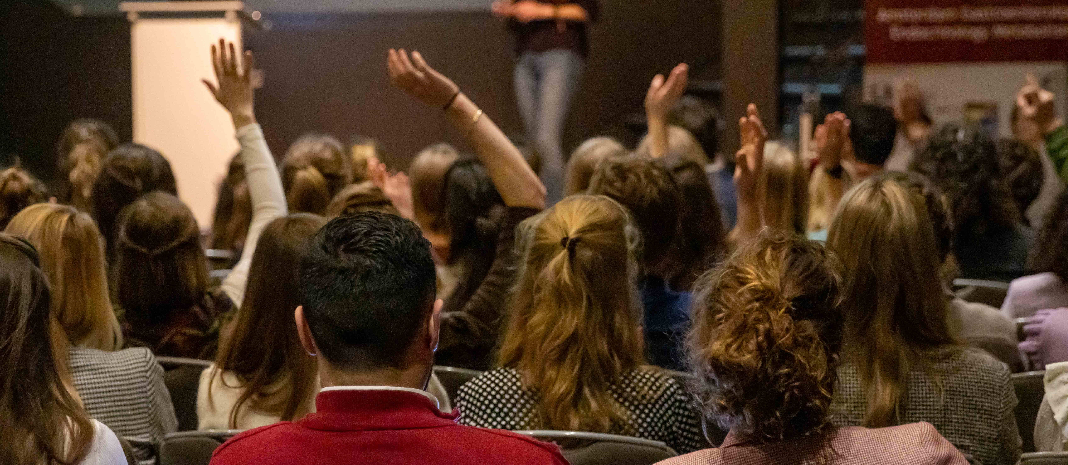
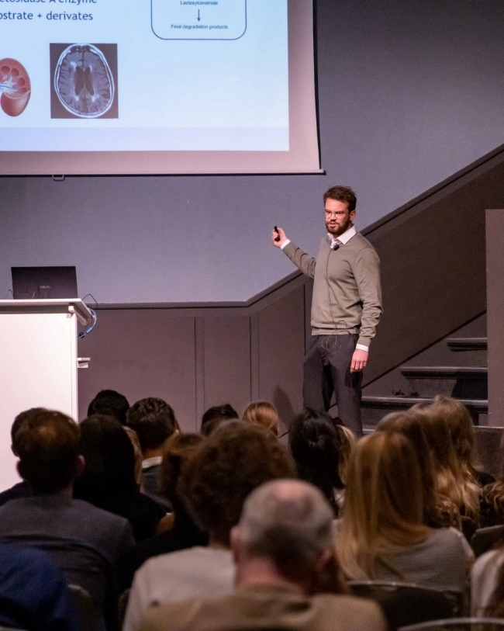
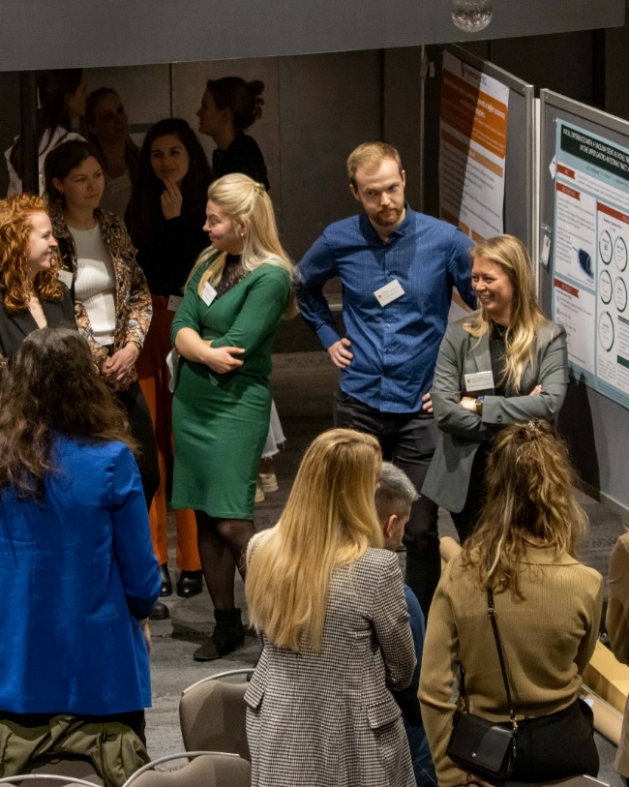
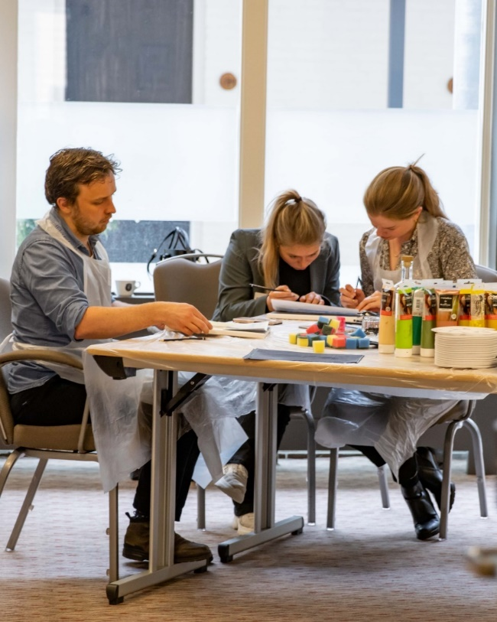
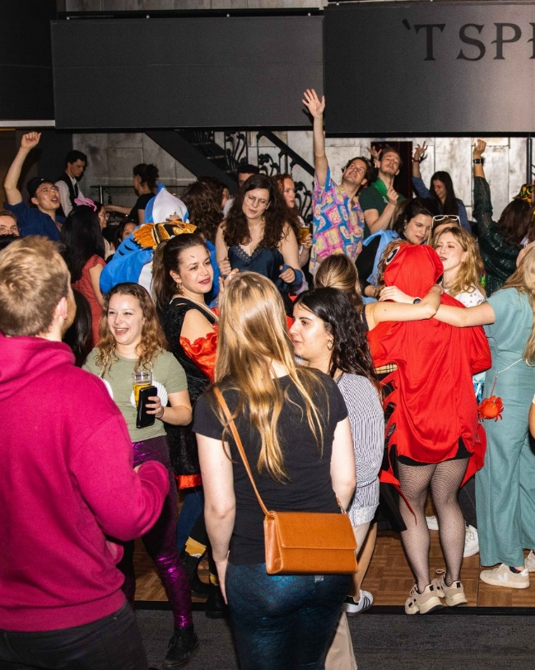
Amsterdam Gastroenterology Endocrinology Metabolism
AGEM RETREAT
March 14 & 15 2024
Abstract submission deadline:
January 12th 2024
Location: Bilderberg Hotel ‘t Speulderbos, Garderen
agemretreat@amsterdamumc.nl

Slide 6
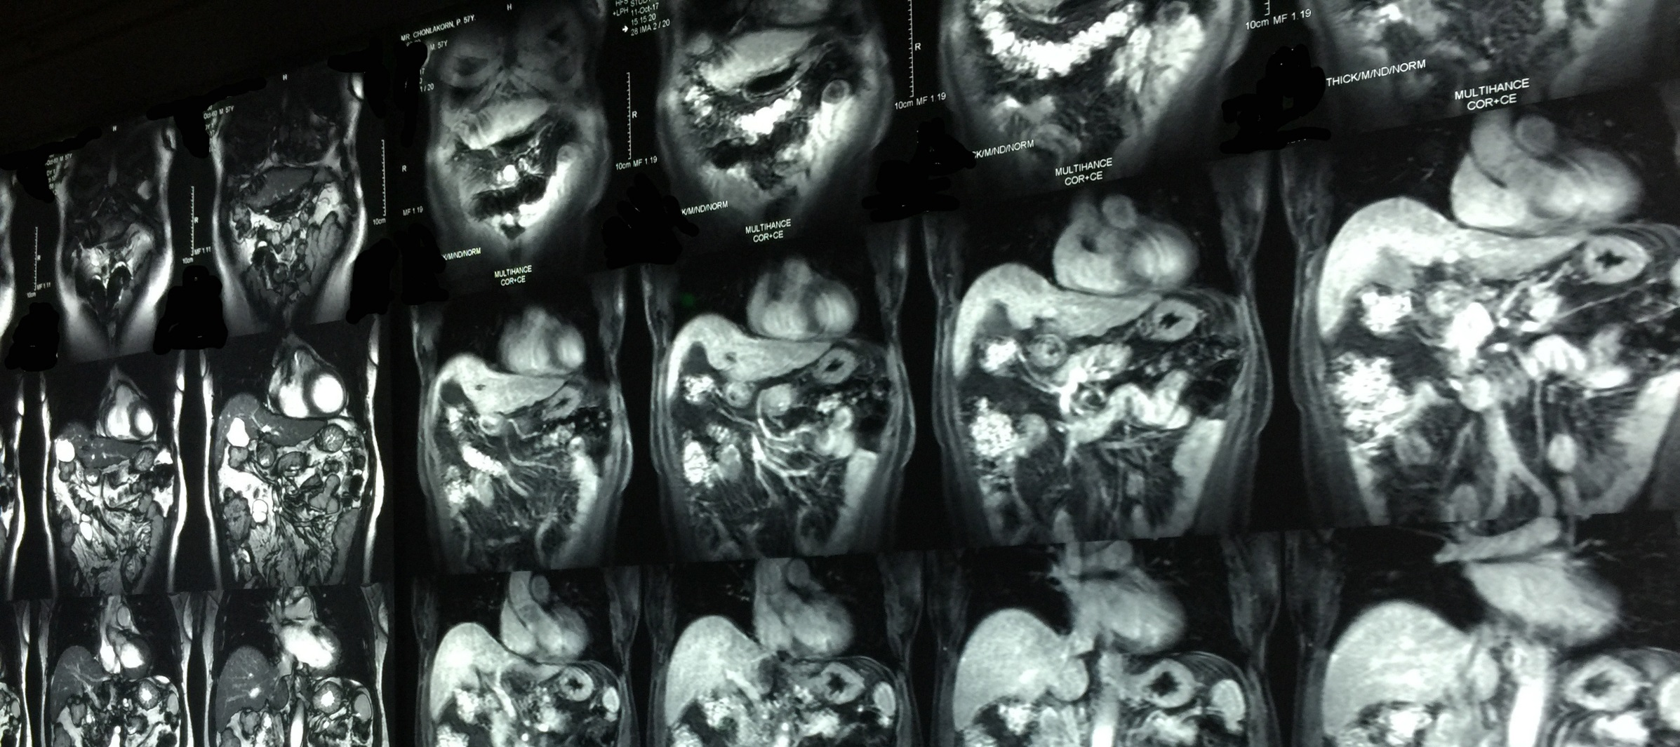
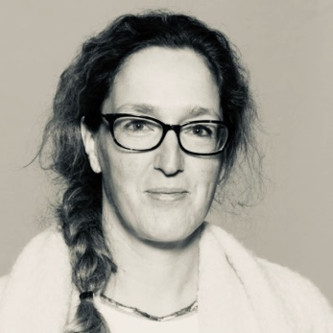
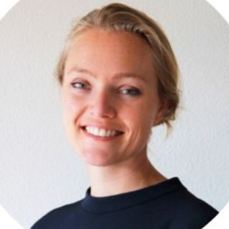
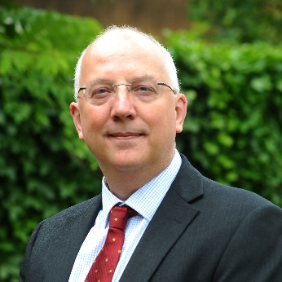
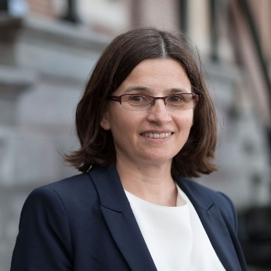
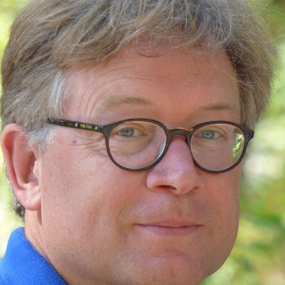
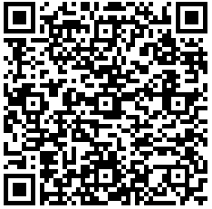
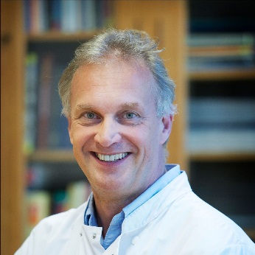
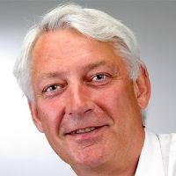
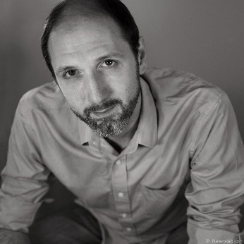
Amsterdam Gastroenterology Endocrinology Metabolism
AGEM SYMPOSIUM
I
magine
20-nov-2019
the
10:00-17:30h
maging
including lunch en drinks
SPEAKERS
LOCATION
De Nieuwe Liefde
Da Costakade 102
Amsterdam
SESSION 1
Karin Horsthuis
Bram Coolen
Anouk Schrantee
Registration and program:
SESSION 2
Luca Marciani
Ivana Išgum
Jan Booij
SESSION 3
Registration deadline
November 15th 2019
Maarten Jacobs
Frits Koning
Marko Popovic
Amsterdam Gastroenterology Endocrinology Metabolism

